Slide 1

Code Contracts
Workshop Code Contracts
Rainer Stropek
software architects gmbh
Web
Mail
Twitter
http://www.timecockpit.com
rainer@timecockpit.com
@rstropek
Workshop

Slide 2
What are Code Contracts
Conditions
Preconditions
Postconditions
Object invariants
Runtime Checking
Rewrites IL Code
Conditional
Static Code Analysis
Documentation
E.g. with Sandcastle

Slide 3
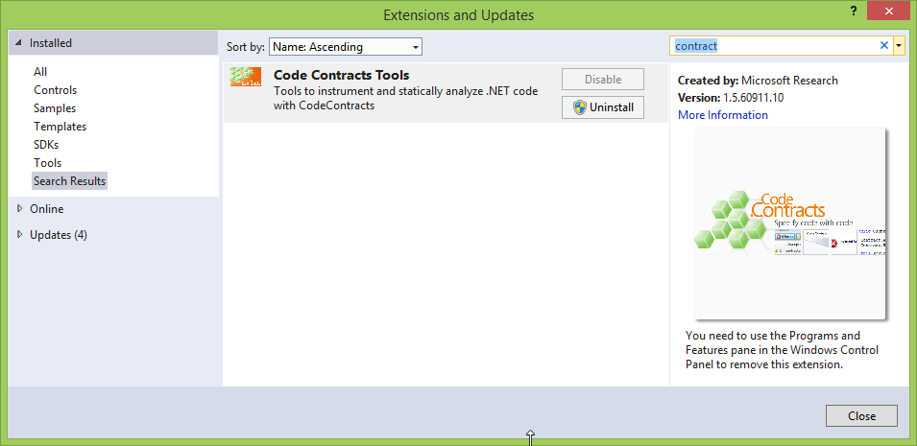
Code Contracts in .NET and VS
System.Diagnostics.Contracts namespace
Visual Studio Gallery

Slide 4
Runtime Checking
Checking in Released Code
no
yes
Rewrite Release Builds?
Runtime Checking on Debug Builds only
yes
no
Runtime Checking on all Builds
Manual „if-then-throw“, Runtime Checking on Debug Builds only

Slide 5
Preconditions
Contract.Requires(x != null);
// Use the following syntax if you need to throw a specific
// exception. This is only available if you run code contracts
// rewriter on all builds.
Contract.Requires<ArgumentNullException>(x != null, "x");
// „Legacy requires“ – necessary if you want runtime checking
// even on release builds without running code contracts
// rewriter
if ( x == null )
{
// Single throw statement, nothing else!
throw new …Exception(…);
}
// No „else“ clause
…
// Necessary after all “legacy requires”
Contract.EndContractBlock();
Contract.Requires
Note that members mentioned in preconditions must have proper visibility
Important so that caller could check precondition prior calling
See also ContractPublicPropertyName

Slide 6
Postconditions
Contract.Ensures(this.X > 0);
// Postcondition in case of an exception
Contract.EnsuresOnThrow<Exception>(this.X == 0);
// Postcondition on result
Contract.Ensures(Contract.Result<int>() > 0);
// Accessing old values in ensures
Contract.Ensures(Contract.OldValue(this.X) < this.X);
// Postcondition on out variables
Contract.Ensures(Contract.ValueAtReturn(out x) > 0);
Contract.Ensures
Note that all postconditions for async methods are checked when the method returns the task
Exception: Ensures that contain Contract.Result<…>().Result

Slide 7
Invariants
[ContractInvariantMethod]
private void ObjectInvariant()
{
// Nothing else than calls to Contract.Invariant
Contract.Invariant(this.x >= 0);
Contract.Invariant(this.x > this.y);
...
}
// Use invariants on automatic properties instead of pre- and
// postconditions
public int X { get; private set; }
[ContractInvariantMethod]
private void ObjectInvariant()
{
// Will become Contract.Ensures in property getter and
// Contract.Requires in property setter
Contract.Invariant(this.X >= 0);
}
ContractInvariantMethod
Conditions indicating whether an object is in a valid state
Checked at the end of each public method

Slide 8
Assert and Assume
// Checked during runtime and static code analysis
Contract.Assert(this.x > 0);
// Checked during runtime but not proven through static code
// analysis
Contract.Assume(this.x > 0);

Slide 9
Quantifications
Contract.Requires(Contract.ForAll(
listOfValues, // IEnumerable
value => value > 0));
// Indexed-based syntax
Contract.Ensures(Contract.ForAll(
0,
Contract.Result<int[]>().Length,
index => Contract.Result<int[]>()[index] > 0))
Alternatives
Contract.Exists
Enumerable.All
Enumerable.Any

Slide 10
Contract Helpers
static class ContractHelper
{
// Helper methods for „legacy requires“
[ContractArgumentValidator]
public static void NotNull(object arg, string paramName)
{
if (arg == null)
{
throw new ArgumentNullException(paramName, …);
}
Contract.EndContractBlock();
}
}
ContractHelper.NotNull(x, "x");
Use ContractArgumentValidator for legacy requires
Use ContractAbbreviator for set of contracts

Slide 11
Contract Inheritance
Contracts are inherited
Preconditions must be defined at the root of the inheritance chain
Ancestors cannot have weaker or stronger preconditions
Add stronger postconditions or invariants in ancestor types if needed

Slide 12
Additional Topics
Contracts for interfaces and abstracts
See ContractClass and ContractClassFor
Use Pure attribute to mark side-effect free methods
Such methods can appear in contracts
Explicitly control runtime checking and inheritance
ContractRuntimeIgnored
ContractOption

Slide 13
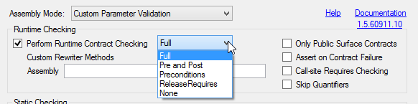
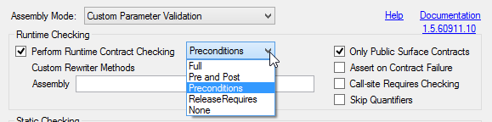
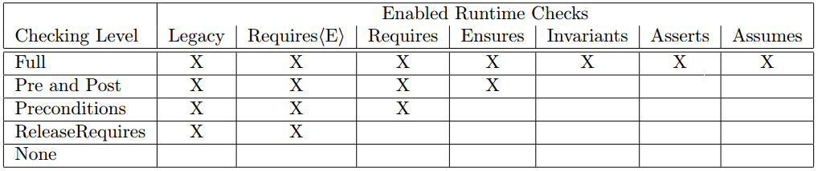
Tips, Tricks, and Best Practices
Do you want to have runtime checking on release builds?
If yes, decide whether you want to run code contract rewriter on release builds
Example
Debug Release
Source: Code Contracts User Docs

Slide 14
Tips, Tricks, and Best Practices
[TestClass]
public class InitializeTests
{
[AssemblyInitialize]
public static void AssemblyInitialize(TestContext tc)
{
Contract.ContractFailed += (sender, e) =>
{
e.SetUnwind(); // cause code to abort after event
Assert.Fail(e.FailureKind.ToString() + ":" + e.Message);
};
}
}
Make sure that contract failures are not hidden with try-catch during unit tests
Don‘t write unit tests to intentionally contract failures
Exception: Legacy requires

Slide 15

Tips, Tricks, and Best Practices
If necessary, you can alert other developers to use code contract tools for building
Code contract tools install handy code snippets
Deliver a Contract Reference Assembly
Make contracts available to referencing assemblies
Add contract information in XML doc file
Sandcastle understands them
For details see Code Contracts User Docs

Slide 16
Q&A
Workshop Code Contracts
Rainer Stropek
software architects gmbh
Mail Web Twitter
rainer@timecockpit.com http://www.timecockpit.com @rstropek
Thank your for coming!

